Slide 1

Topic 3: Functions and Vectors

Slide 2
Course Overview
Topic | Description
Session 1
1 | Introduction to R and R Studio Cloud
2 | Exploratory Data Analysis: the tibble and ggplot2
3 | Functions, Vectors and Lists
4 | Introduction to Functionals with purrr
5 | Data Transformation I with dplyr
Session 2
6 | Data Transformation II with dplyr
7 | Statistical Transformation with ggplot2
8 | Advanced Functionals and Modelling with purrr
9 | Exploratory Data Analysis - Case Study using aimsir17

Slide 3
R – Data Types
 | Homogenous | Heterogenous
1d | Atomic Vector | List
2d | Matrix | Data Frame
nd | Array
The basic data structure in R is the Vector
Vectors come in two flavours
Atomic vectors
Lists
With atomic vectors, all elements have the same type

Slide 4
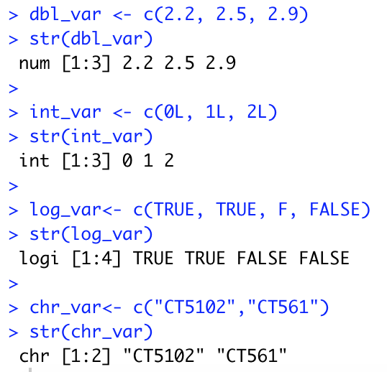
(1) Atomic Vectors
Four common types
logical
integer
double (or numeric)
character
Usually created with c() – short for combine

Slide 5
Creating atomic vectors using sequences
The colon operator (:) generates regular sequences (atomic vectors) within a specified range.
> v1<-1:10
> v1
[1] 1 2 3 4 5 6 7 8 9 10
> v2<-3:13
> v2
[1] 3 4 5 6 7 8 9 10 11 12 13

Slide 6
Coercion of atomic vectors
All elements of an atomic vector MUST be of the same type
When different type are combined, they will be coerced into the most flexible types
What will be the type and values of
c(1L, T, F)
c(1,T,F)

Slide 7
Coercion Rules Least to most flexible
logical
numeric
character
TRUE → 1
FALSE → 0
numeric
logical
character
Grolemund (2014) p 52

Slide 8
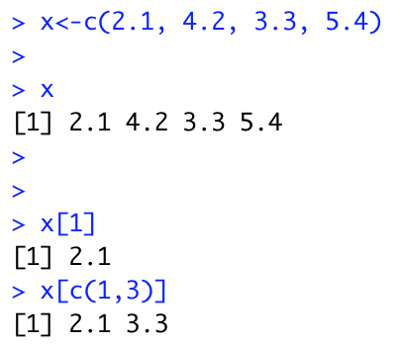
Subsetting Atomic Vectors
Subsetting data is a key activity in data science
R’s subsetting operators are powerful and fast
For atomic vectors, the operator [ is used
In R, the index for a vector starts at 1

Slide 9
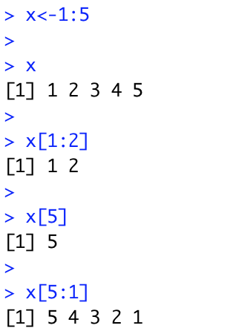
(a) Positive integers
1
2
3
4
5
Positive integers return elements at the specified position
1
2

Slide 10
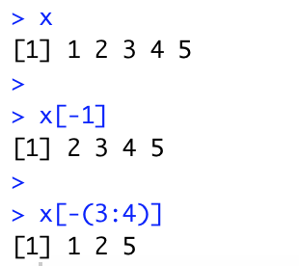
(b) Negative integers
1
2
3
4
5
Negative integers omit elements at specified positions
2
3
4
5

Slide 11
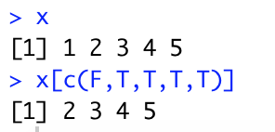
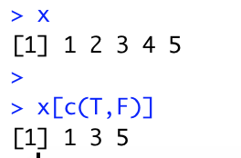
(c) Logical Vectors
1
2
3
4
5
Select elements where the corresponding logical value is TRUE. This approach supports recycling
F
T
T
T
T
2
3
4
5

Slide 12
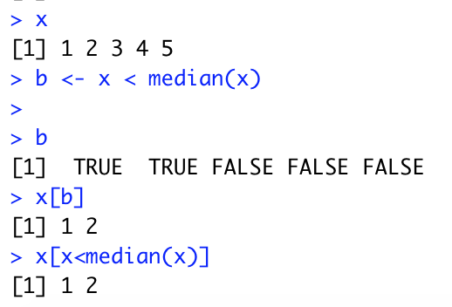
Logical Vectors - Advantages
Expressions can be used to create a logical vector

Slide 13
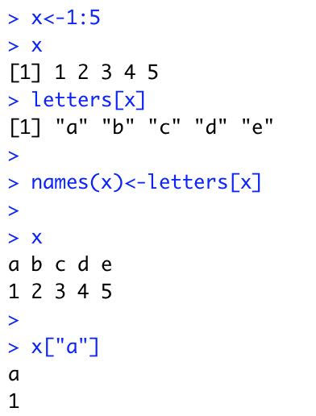
(4) Character vectors to subset
a b c d e
1
2
3
4
5
Return elements with matching names
a
1

Slide 14
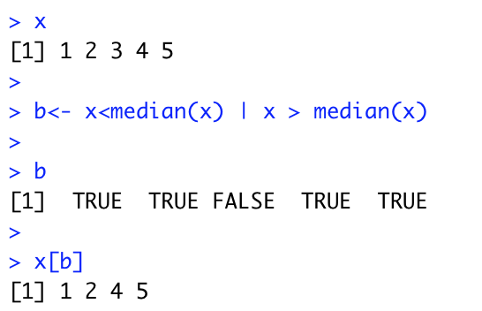
Logical Expressions in R
Operators | Description
< | less than
<= | less than or equal to
> | greater than
>= | greater than or equal to
== | exactly equal to
!= | not equal to
!x | not x
x | y | x OR y
x & y | x AND y

Slide 15
Challenge 3.1
Create an R vector of squares of 1 to 10
Find the minimum
Find the maximum
Find the average
Subset all those values greater than the average

Slide 16
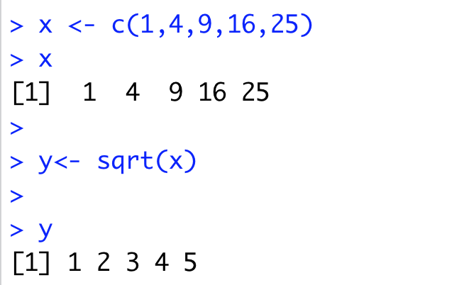
Vectorisation
A powerful feature of R is that it supports vectorisation
Functions can operate on every element of a vector, and return the results of each individual operation in a new vector.

Slide 17
Input Vector
Output Vector
1
1
4
2
sqrt()
9
3
16
4
25
5

Slide 18
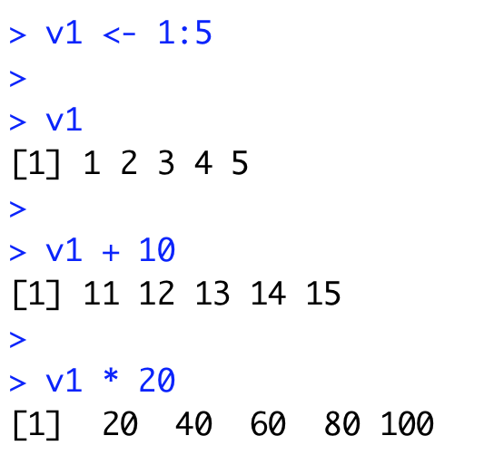
Arithmetic Operators
Arithmetic operations can also be applied to vectors in an element-wise manner

Slide 19
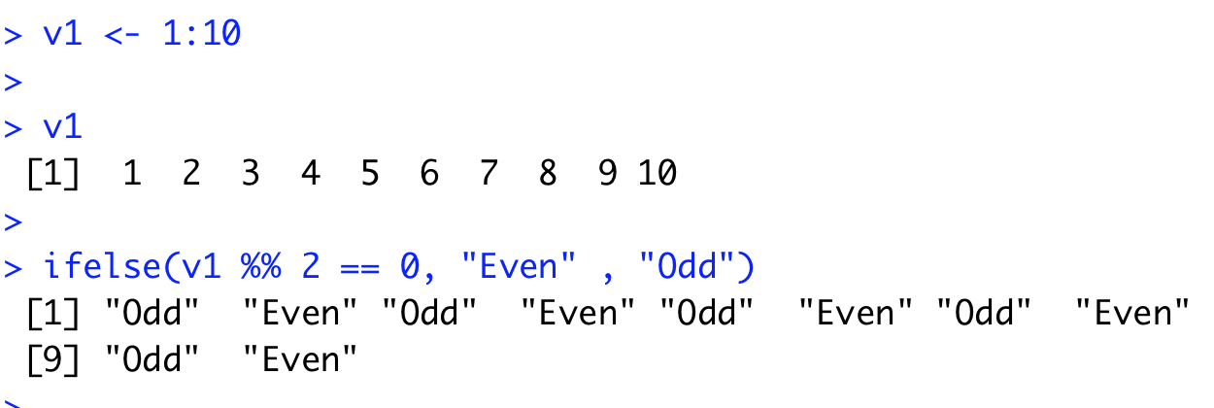
Vectorized if/else
Vectors can also be processed using the vectorized ifelse(b,u,v) function, which accepts a boolean vector b and allocates the element-wise results to be either u or v.

Slide 20
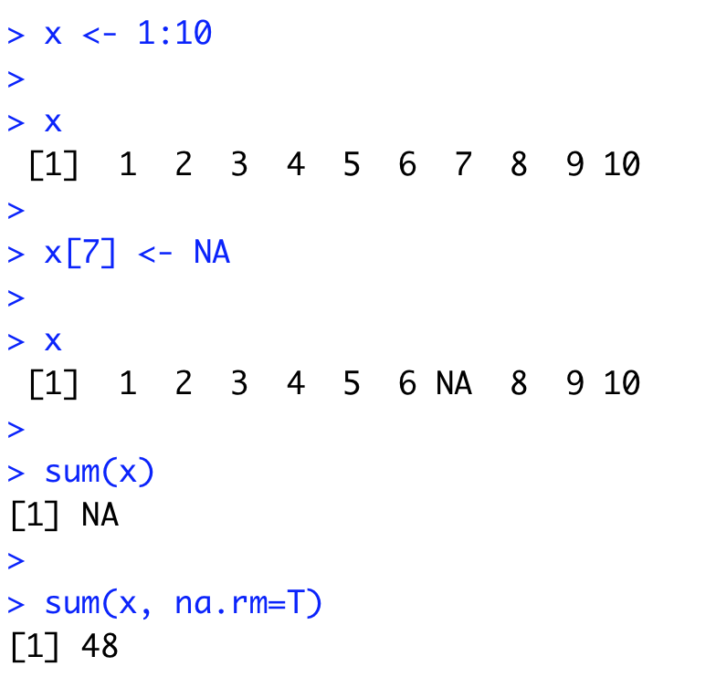
Missing Values - NA
In a project of any size, data is likely to be incomplete due to
Missed survey questions
Faulty equipment
Improperly coded data
In R, missing data is represented by the symbol NA

Slide 21
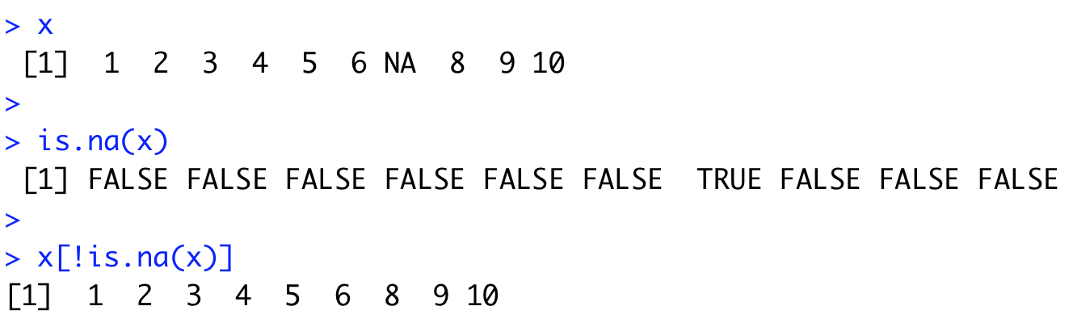
is.na() function
The function is.na() indicates which elements are missing
Returns a logical vector, the same size as the input vector

Slide 22
Challenge 3.2
Create a vector of 20 numbers
Set 5 of these to NA (random)
Print the locations of the missing values
Hint: Check out the R function which

Slide 23
(2) Lists
 | Homogenous | Heterogenous
1d | Atomic Vector | List
2d | Matrix | Data Frame
nd | Array
Lists are different from atomic vectors because their elements can be of any type, including lists.
list() creates a list, instead of c()

Slide 24
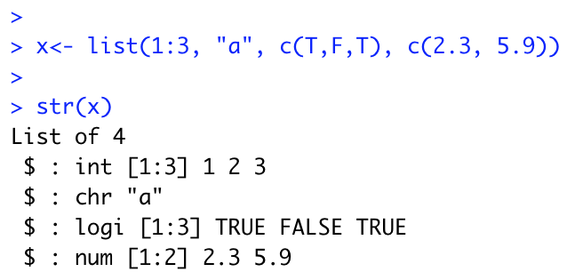
Creating a list…

Slide 25
Subsetting lists
Works in the same way as subsetting an atomic vector
Using [ will always return a list
[[ pulls out the contents of a list
If list x is a train carrying objects, then x[[5]] is the object in car 5, x[4:6] is a train of cars 4-6” @RLangTip
x[[5]]

Slide 26
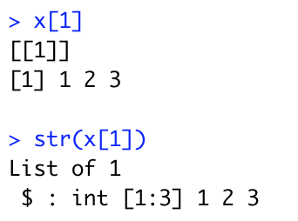
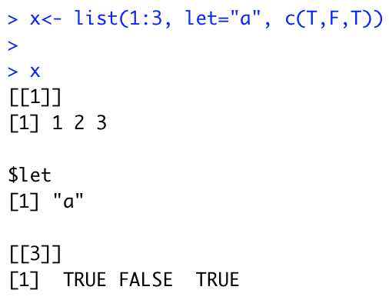
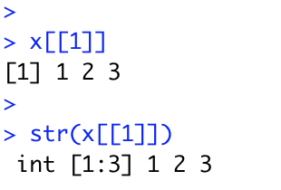
Example

Slide 27
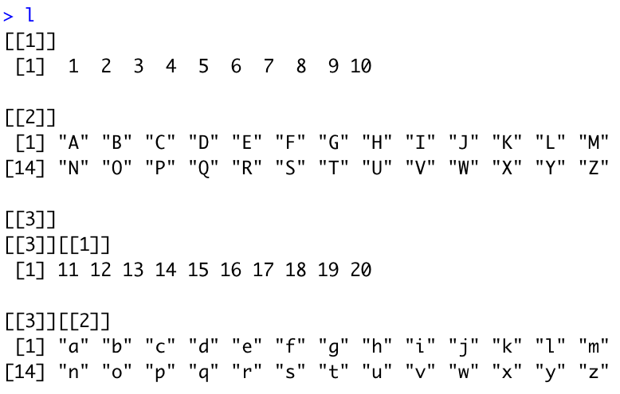
Challenge 3.3
Create a list that contains
A vector of integers (1:10)
A sequence of upper case letters (A-Z)
A list with:
A vector of integers (11:20)
A sequence of lower case letters (A-Z)

Slide 28
Extract the following
The first element as a vector
The second element as a vector
The third element as a list of a list
The third element as a list
The values 10, Q, 19 and the vector “w” ”x” “y”

Slide 29
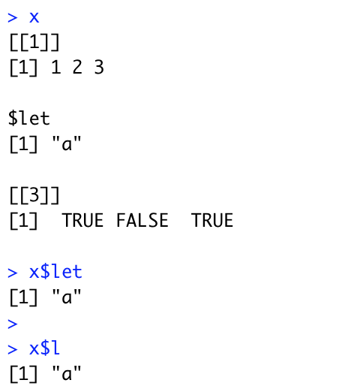
$ operator
$ is a shorthand operator, where x$y is equivalent to x[[“y”,exact=FALSE]]
When list elements are named, it can be used.
Often used to access variables in a data frame
$ does partial matching

Slide 30
Visualising Lists and Subsetting
Lists have rounded corners. Atomic vectors have square corners
Children are drawn inside their parent, and have a slightly darker background

Slide 31
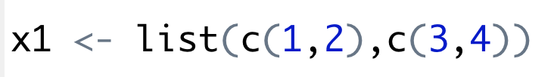
x1
1
2
3
4

Slide 32
a
a[1:2]
1
2
3
1
2
3
“a string”
“a string”
3.141525
-1
-5

Slide 33
a
a[4]
1
2
3
“a string”
-1
-5
3.141525
-1
-5

Slide 34
a
a[[4]]
1
2
3
-1
-5
“a string”
a[[4]][1]
3.141525
-1
-1
-5
a[[4]][[1]]
a[[4]][[2]]
-1
-5

Slide 35
(3) Functions
A function is a group of instructions that:
takes input,
uses the input to compute other value, and
returns a result (Matloff 2009).
Functions are a fundamental building block of R (Wickham 2015)
Users of R should adopt the habit of creating simple functions which will make their work more effective and also more trustworthy (Chambers 2008).
Functions are declared:
using the function reserved word
are objects

Slide 36
General Form
function(arguments)
expression
arguments gives the arguments, separated by commas.
Expression (body of the function) is any legal R expression, usually enclosed in { }
Last evaluation is returned
return() can also be used, but usually for exceptions.
f()

Slide 37
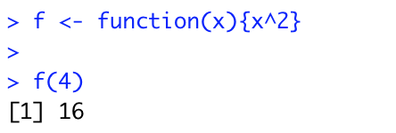

Example
f()

Slide 38
Challenge 3.4
Write an R function that filters a vector to return all the even numbers
1 2 3 4 5
f()
2 4

Slide 39
Function Arguments
It is useful to distinguish between formal arguments and the actual arguments
Formal arguments are the property of the function
Actual arguments can vary each time the function is called.
When calling functions, arguments can be specified by
Complete name
Partial name
Position

Slide 40
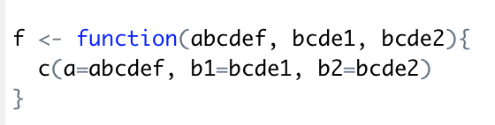
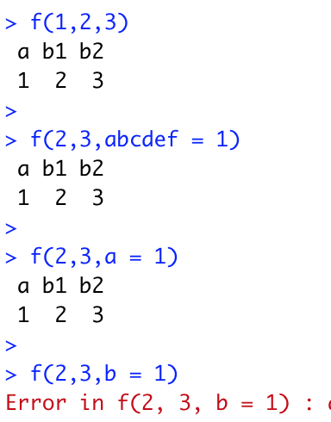
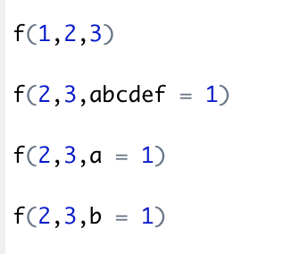

Slide 41
Guidelines (Wickham 2015)
Use positional mapping for the first one or two arguments (most commonly used)
Avoid using positional mapping for less commonly used attributes
Named arguments should always come after unnamed arguments

Slide 42
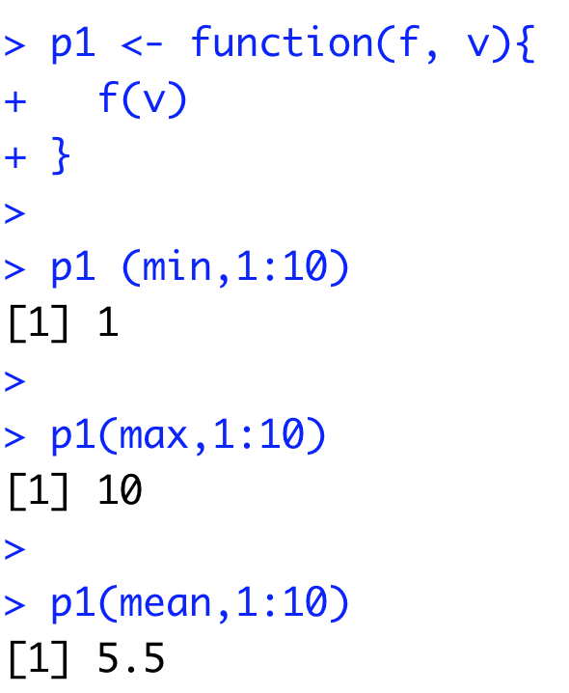
Passing functions as objects
Functions are first class objects, so they can be passed to other functions
Provides flexibility, and widely used in R

Slide 43
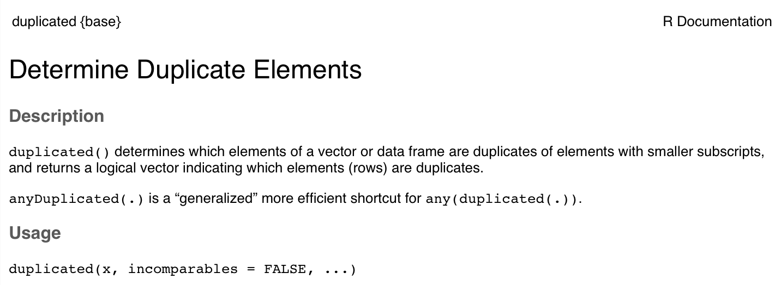
Challenge 3.5
Write a function that takes in a vector and returns a vector with no duplicates. Make use of the R function duplicated()

Slide 44
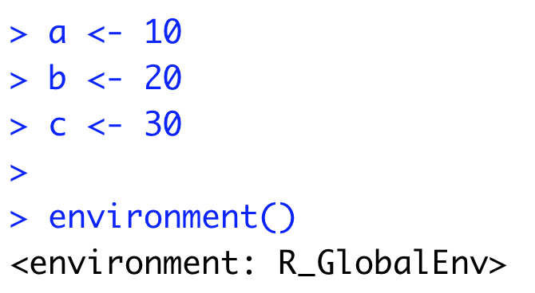
(3) Environments in R
Environments can be thought of as consisting of two things: a frame, which is a set of symbol-value pairs, and an enclosure, a pointer to an enclosing environment
Every object (variable or function) in an environment has a unique name
The working environment is known as the Global Environment
b
c
a

Slide 45
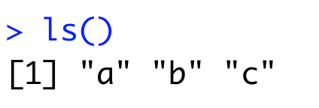
Hierarchy of Environments
globalenv()
baseenv()
emptyenv()
Environments form a tree structure in which the enclosures play the role of parents. The tree of environments is rooted in an empty environment, available through emptyenv(), which has no parent

Slide 46
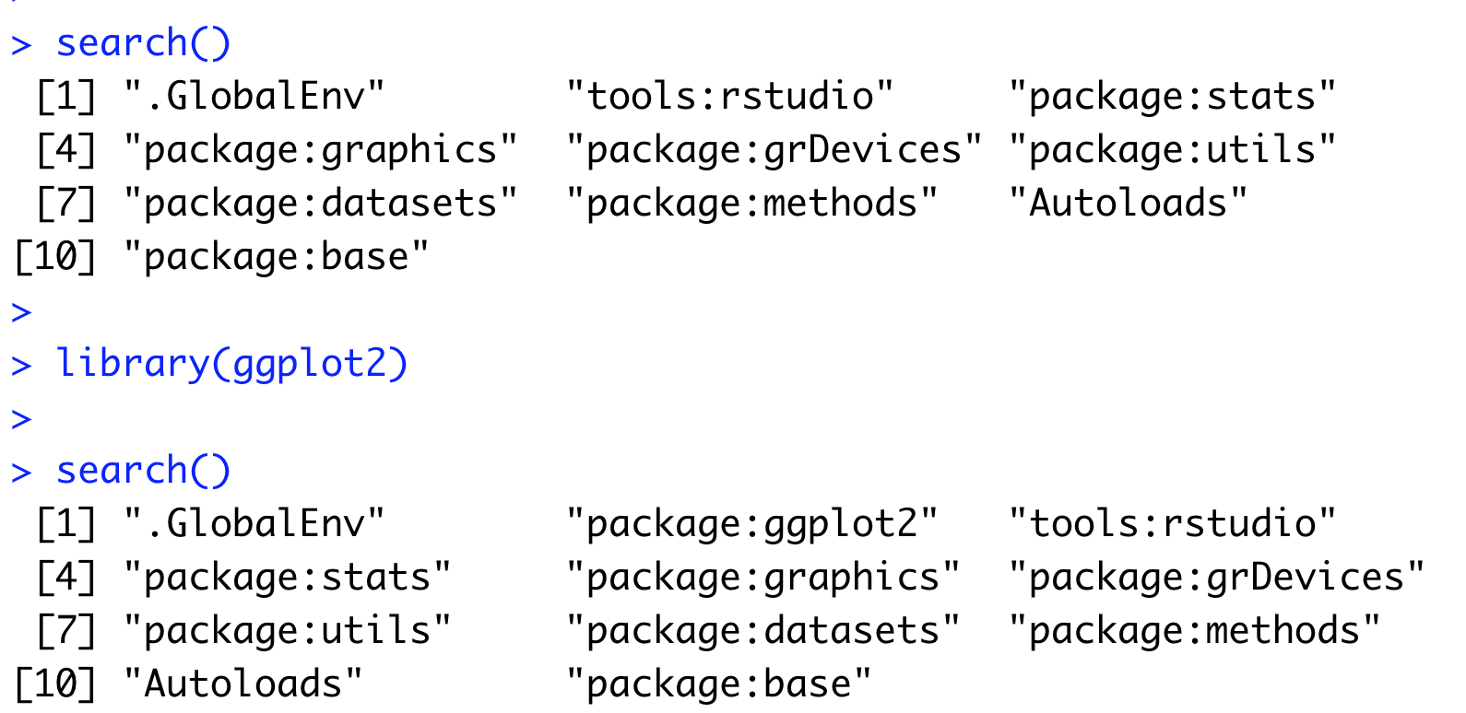
Examining the hierarchy with search()

Slide 47
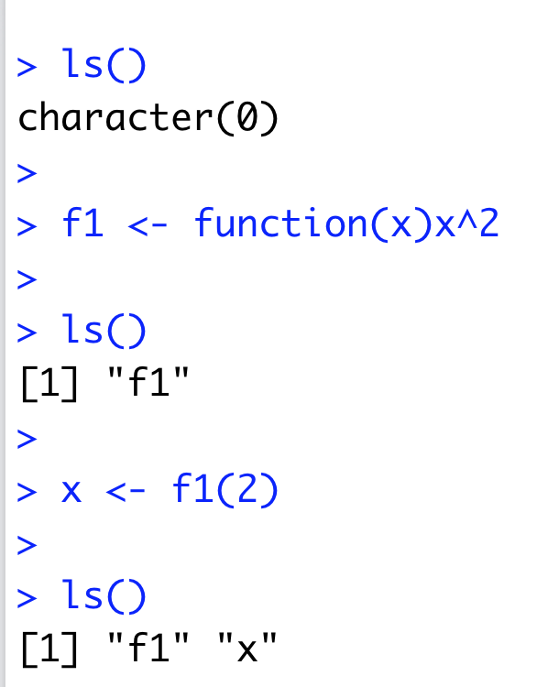
Functions and their Environment
Functions are first class objects that exist in an environment
Functions can access all variables contained in their enclosing environment
When functions are executed, they have their own environment (to be covered later in the advanced topic)

Slide 48
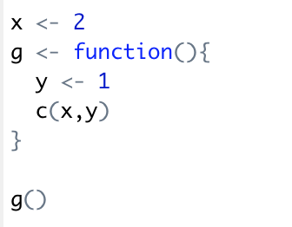
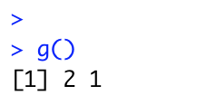
Looking for variables…
If a name isn’t defined inside a function, R will look one level up to the enclosing environment.

Slide 49
Challenge 3.6
Write a function in R that will return the square of a number in its environment.

